Slide 1
Customer Churn for a Telecom Company
Naomi Ajayi

Slide 2
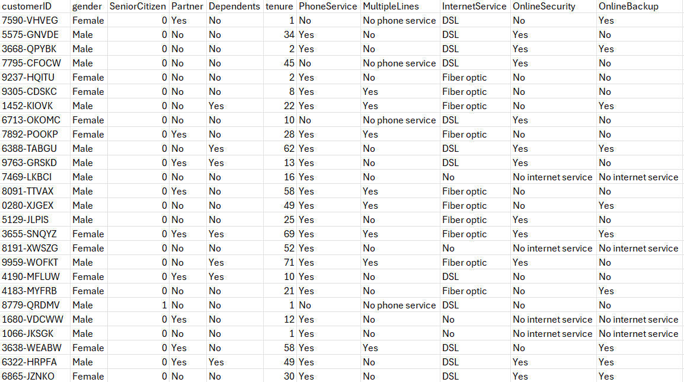
Business Case
Our goal is to help a telcompany identify churn to prevent unnecessary profit loss by using predictive models like logistic regression, decision tree, and KNN.
This dataset provides multiple factors, such as gender, customer tenure, type of contract, and more.
The data set is from Kaggle, and has over 7,000 observations.

Slide 3
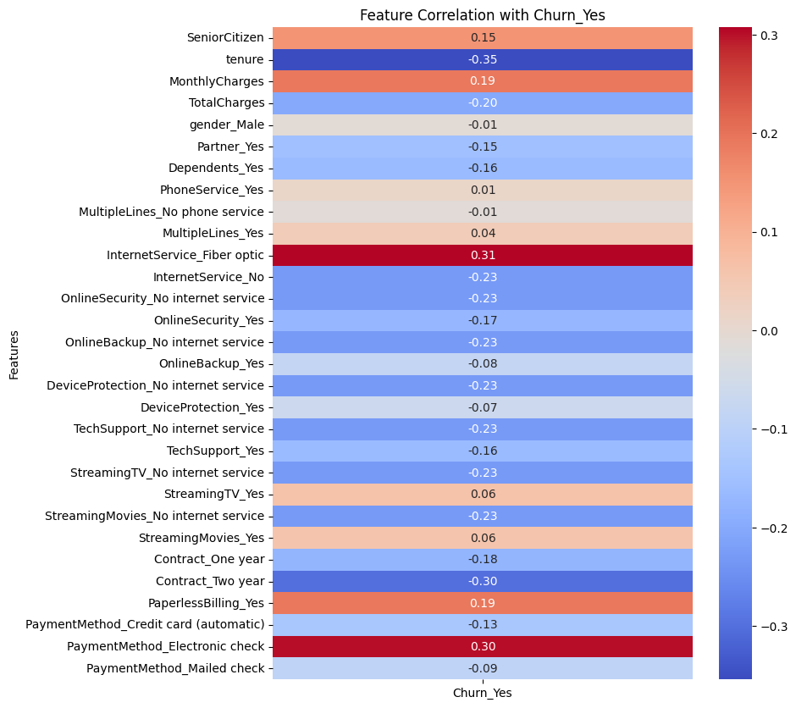
Data Preprocessing
Predictor Variable Selection:
To predict churn we based the variable selection on domain logic and heatmap.
Tenure
  The length that the customer has been with the company.
Contract type
  Month to month contracts effects the churn rate because customers can leave more easily than someone with a shorter contract.
Monthly charges
  High monthly charges causes dissatisfaction and increases the churn rate
Internet service type
  Customers using fiber optic internet (premium service) which is high in monthly charges and fees can cause churn
Payment method (e-checks)
  Customers using e-checks in telecom companies are more aware of monthly billing increase and are more likely to cancel when they feel they are overcharged
Tech support availability
  Lack of tech support increases chances of churn

Slide 4
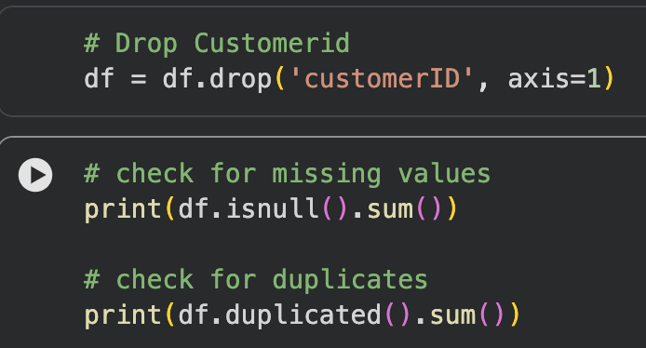
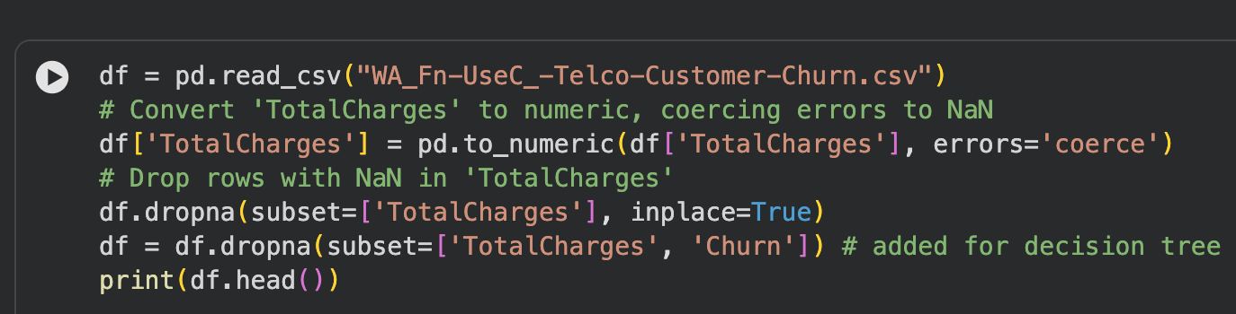
Data Preprocessing
Transformation:
Dropped CustomerID
  It’s an identifier and doesn’t have any predictive information
  df = df.drop('customerID', axis=1)
Converted ‘TotalCharges’ to numeric and dropped rows with missing ‘TotalCharges’
  Some rows had spaces/ characters
Check missing values
Check for duplicates
Partitioning:
Split train/ testing 0.2 test size and 0.8 training size

Slide 5
Models:
Logistic Regression
Decision Tree
K-Nearest Neighbors (KNN)
Logistic Regression:
Handles binary classification and in this case it works well for predicting churn
It can manage large datasets
Decision Tree:
Can handle categorical and numerical features
K-Nearest Neighbors (KNN):
Identify patterns in churn

Slide 6
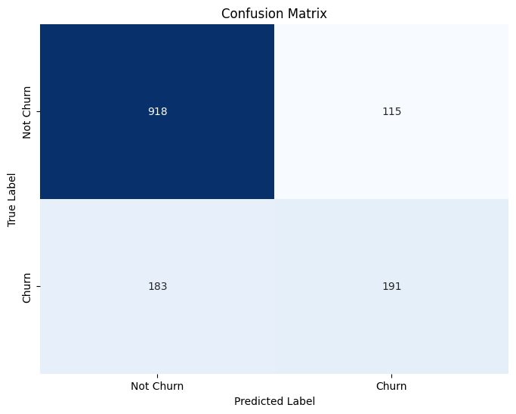
Logistic Regression
Accuracy: 78.82%
Precision for 0 (no churn): 83%
Precision for 1 (churn): 62%
True negative (918) -> predicting loyal customers (no churn)
False positive (115) -> customers who did not churn but the model predicted churn
False negative (183) -> customers who did churn but the model predicted no churn
True positive (191) -> customers who did churn and the model predicted churn
This means the model does well in predicting no churn, while it may struggle to predict customers who actually do end up churning.

Slide 7
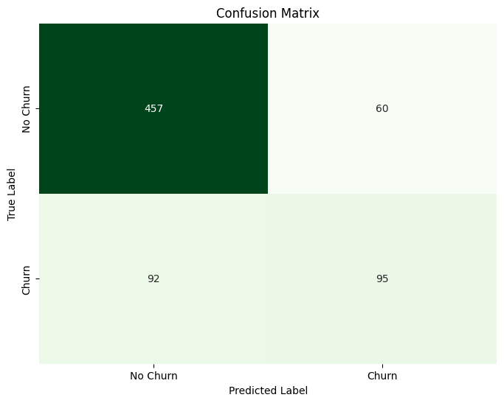
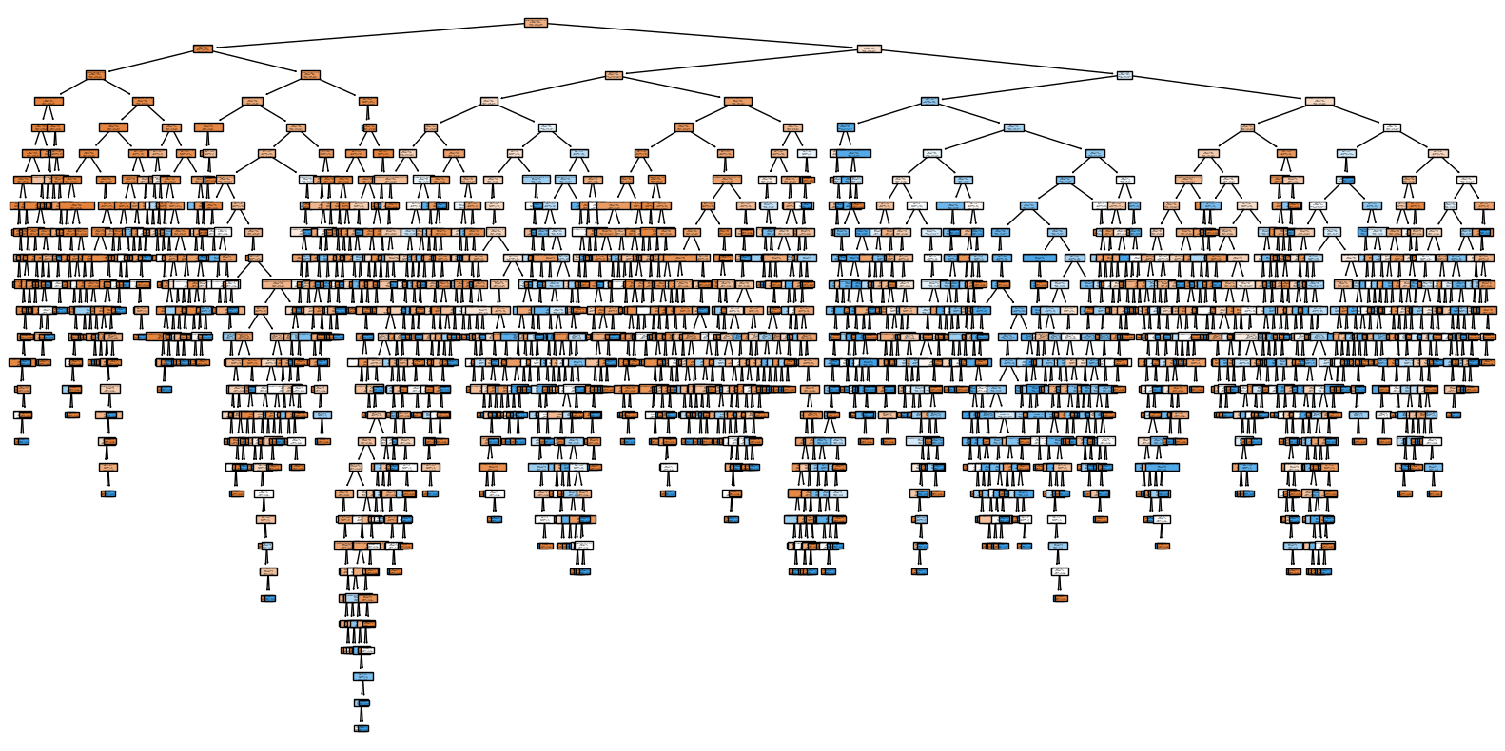
Decision Tree
Precision for 0 (no churn): 83%
Precision for 1 (churn): 61%
The model is predicting high true negative, which is a good sign because most customers do not churn.
It also shows a higher number of false negatives than false positives which indicates that it still struggles to predict customers who actually churn.

Slide 8
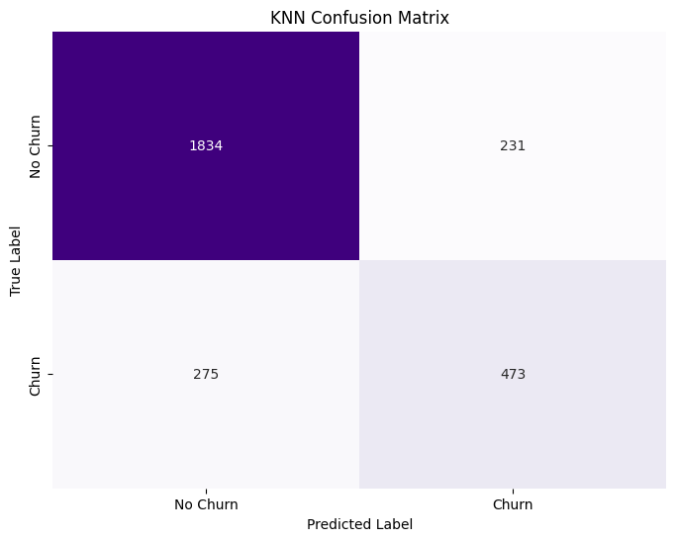
K-Nearest Neighbors (KNN)
Overall Accuracy: 82.01%
Precision for 0 (No Churn) = 86.96%
Precision for 1 (Churn) = 67.19%
True Negative: 1834 -> customers were predicted to not churn and did not churn
True Positive: 473 -> customers were predicted to churn and churned
False Negative: 275 -> customers were predicted to not churn but churned
False Positive: 231 -> customers were predicted to churn but did not
This model predicts people who will not churn (loyal customers) more accurately than it does customers who will churn.

Slide 9
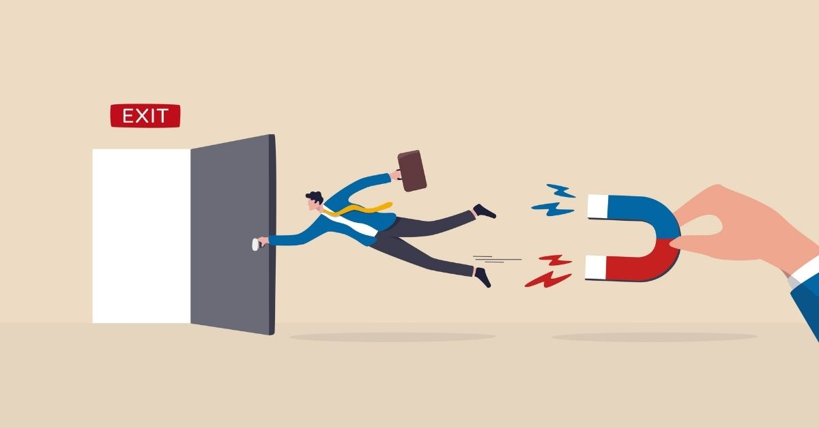
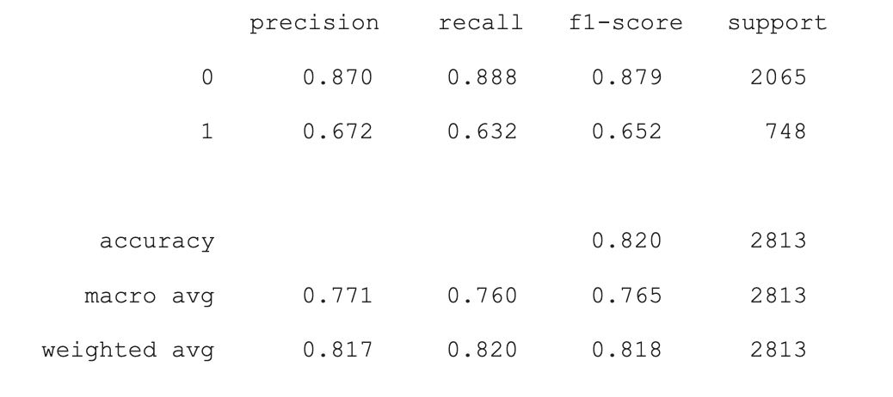
Business Implication
Results:
KNN model performed the best
Managerial insights:
Identify loyal customers
Offer discounts/ loyalty rewards to customers, especially those not predicted as loyal
We can still show special attention to the 67% of customers who are accurately predicted as a churn risk

Slide 10
Thank you!
Any questions?

